Slide 1

Avalanche Forecasting using ML
For saving Lives
By :- Anubhav Mishra
Manaswini Nagasamudram
Jujjuri Leelasatyakrishna
Shivesh Jha
Tanish Chaudhary

Slide 2
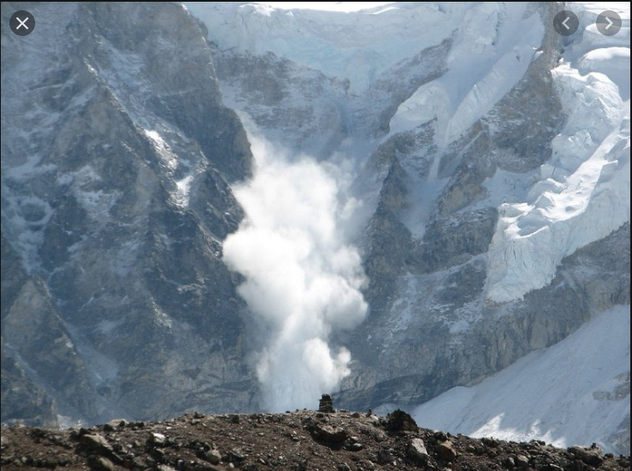
What avalanche really is......
An avalanche is a mass of snow that slides rapidly down an inclined slope, such as a mountainside or the roof of a building. Avalanches are triggered by either natural forces (e.g. precipitation, wind drifting snow, rapid temperature changes) or human activity.

Slide 3
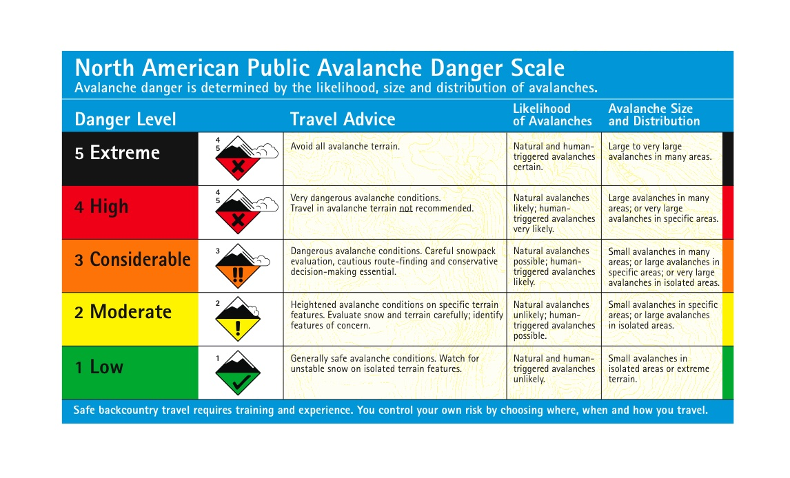
Example

Slide 4
Types of avalanche
Wet Avalanches
Dry (Powder) Avalanches
Dry Slab Avalanches
Loose Snow Avalanches

Slide 5
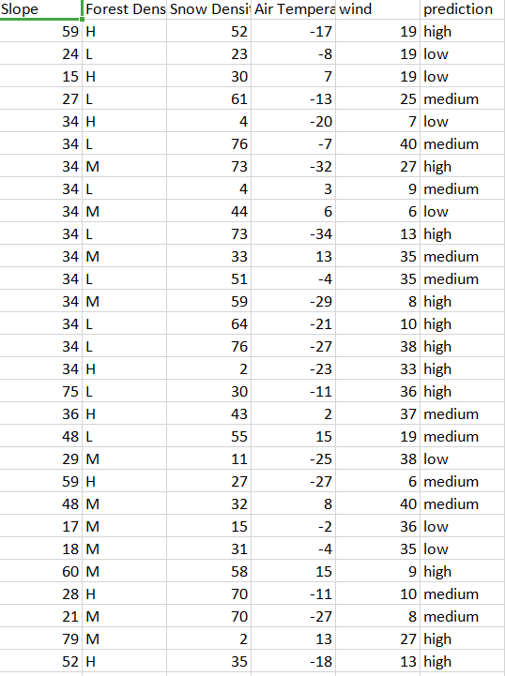
Parameters :
Slope
Forest Density
Snow Density
Air Temperature
Wind

Slide 6
Slope - It is measured in degrees.
Forest Density - It is measured under dataset as low,medium and high.
Snow Density - It is measured in Kg per cubic meter.
Temperature - It is measured in Celsius.
Wind – It is measured in Mile per hour

Slide 7
Slope in degrees | Prediction Affected (Avalanche)
Less than 30 | Low
30 to 40 | Medium
More than 30 | High
Forest Density | Prediction Affected (Avalanche)
Low | High
Medium | Medium
High | Low
Snow Density | Prediction Affected (Avalanche)
Less than 20 (<20) | Low
20 - 50 | Medium
More than 50 | High
Temperature | Prediction Affected (Avalanche)
Less than -10(Freezing) Greater (> 8 degrees) | High
Between -10 to 8 degree | low

Slide 8
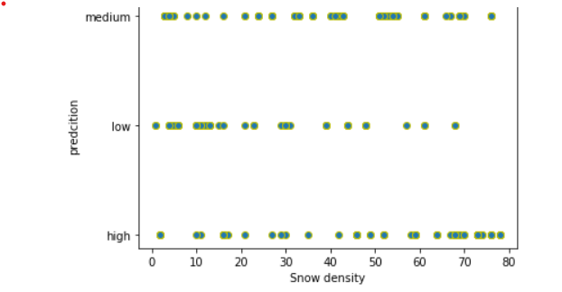
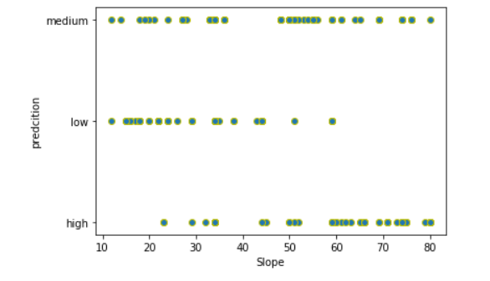
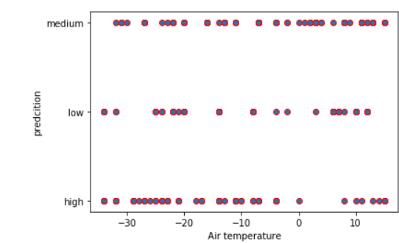
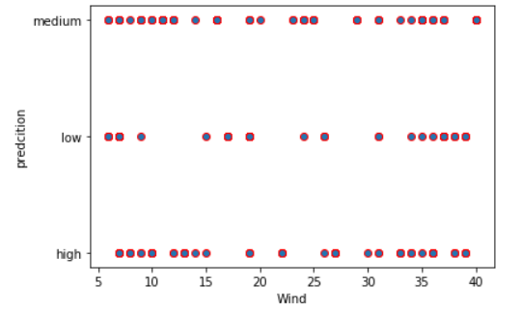
Data Visualization:

Slide 9
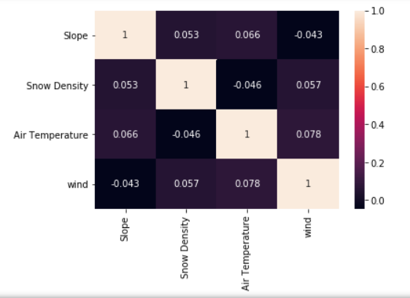
Heat Map
Diagonals are strongly related.
Strong correlation(near to 1)
Weak correlation(near to -1)

Slide 10
Outcomes(Analysis)
If the slope increases then at high altitude the temperature gets reduced which results in high chances of avalanches.
Forest density at higher altitudes can be reasonably high which effects in increase of avalanche occurrence.

Slide 11
Applied Algorithms -:
Random Forest Classification.
Accuracy Score :- 0.8292
Decision Tree Classification.
Accuracy Score :- 0.8536

Slide 12
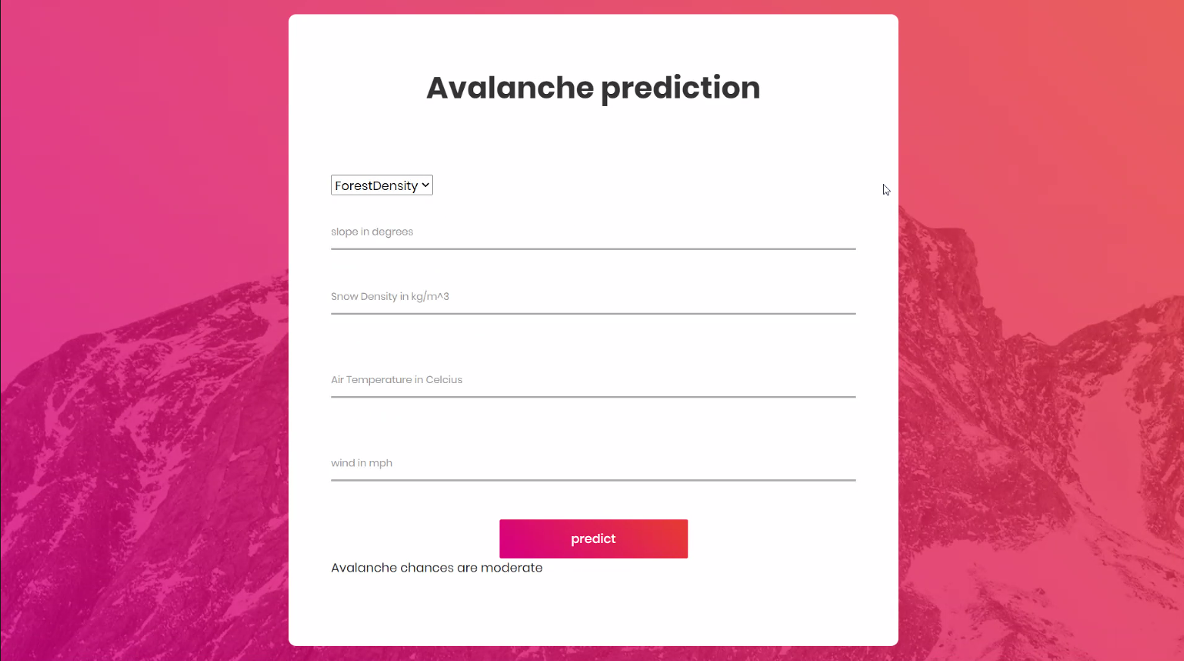
Application(UI)

Slide 13
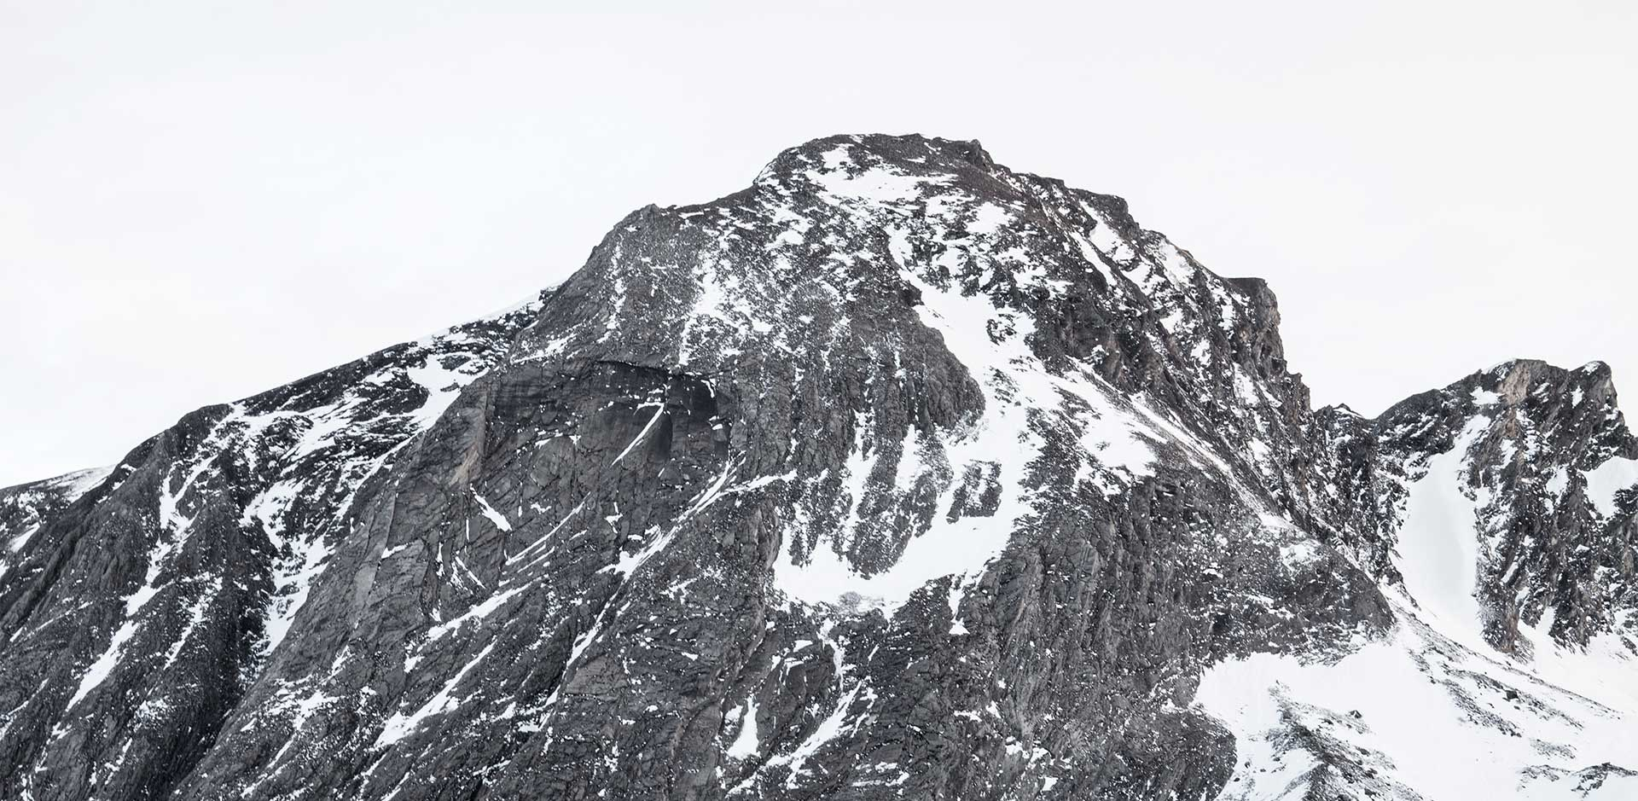
Thank You

